Slide 1


WORK-CASE №2
Virtualization: A Hands-On Guide
This guide will walk you through setting up and configuring virtual machines using a hypervisor of your choice. We'll cover the basics of creating, customizing, and connecting virtual machines to your network.
Created: Krasavin Volodymyr

Slide 2

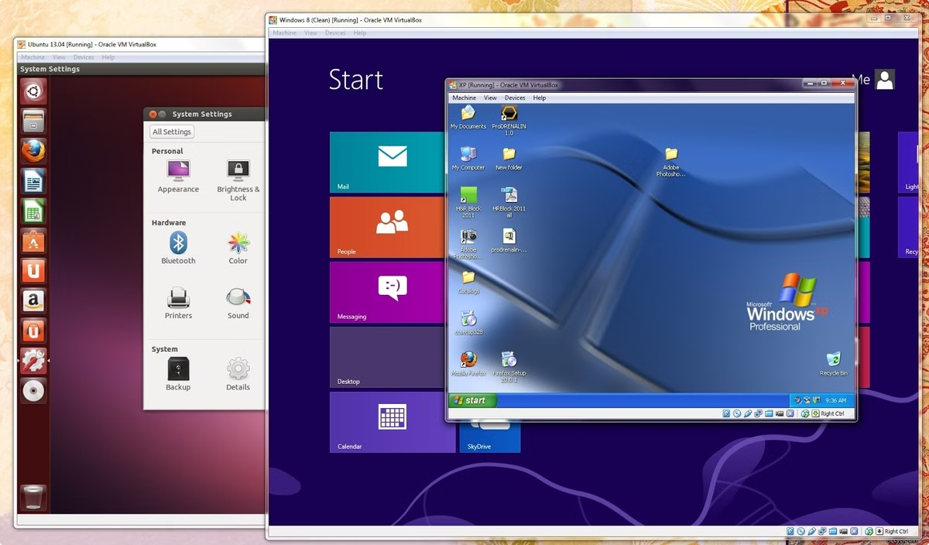
Hypervisor Setup
VirtualBox
A popular and free hypervisor, known for its user-friendly interface.
VMware Workstation
A powerful and feature-rich hypervisor, often used for professional purposes.
Hyper-V
A built-in hypervisor for Windows operating systems, offering robust virtualization capabilities.

Slide 3

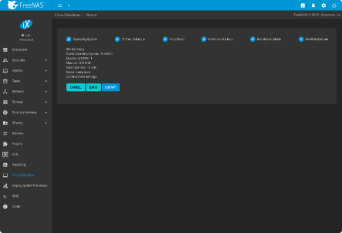
Creating a Virtual Machine
1
2
3
Select Hypervisor
Configure Settings
Start the Virtual Machine
Choose the hypervisor that best suits your needs and system requirements.
Specify the operating system, memory allocation, and storage space for the virtual machine.
Initiate the virtual machine and install the desired operating system.

Slide 4
Hardware Configuration
CPU Cores
RAM
Storage
Allocate the number of CPU cores that the virtual machine can use.
Assign a specific amount of RAM to the virtual machine.
Create a virtual hard disk for the virtual machine to store its data.

Slide 5


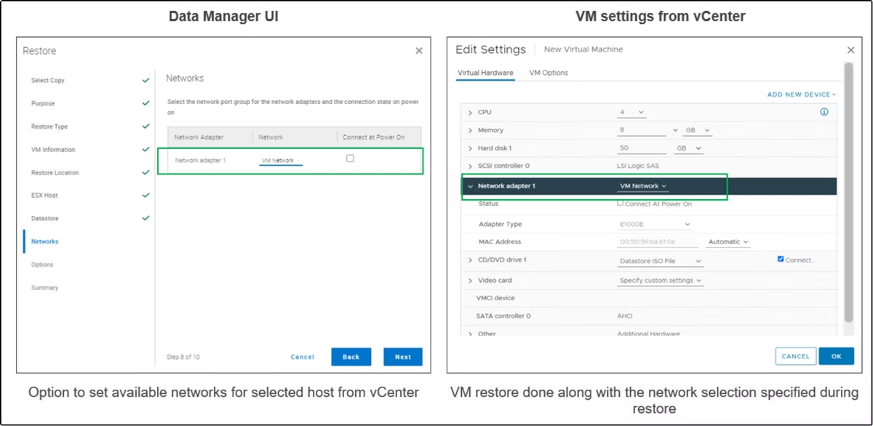


Network and Wi-Fi
Network Adapter
Configure the network adapter type and settings for the virtual machine.
Wi-Fi Connection
Connect the virtual machine to your Wi-Fi network by selecting the appropriate SSID and entering the password.
Network Sharing
Enable network sharing between the host and guest operating systems.

Slide 6


External Storage
1
USB Devices
Connect USB devices, such as flash drives, to the virtual machine.
2
Shared Folders
Share folders from the host operating system with the guest operating system.
3
Network Drives
Access network drives from the virtual machine.

Slide 7

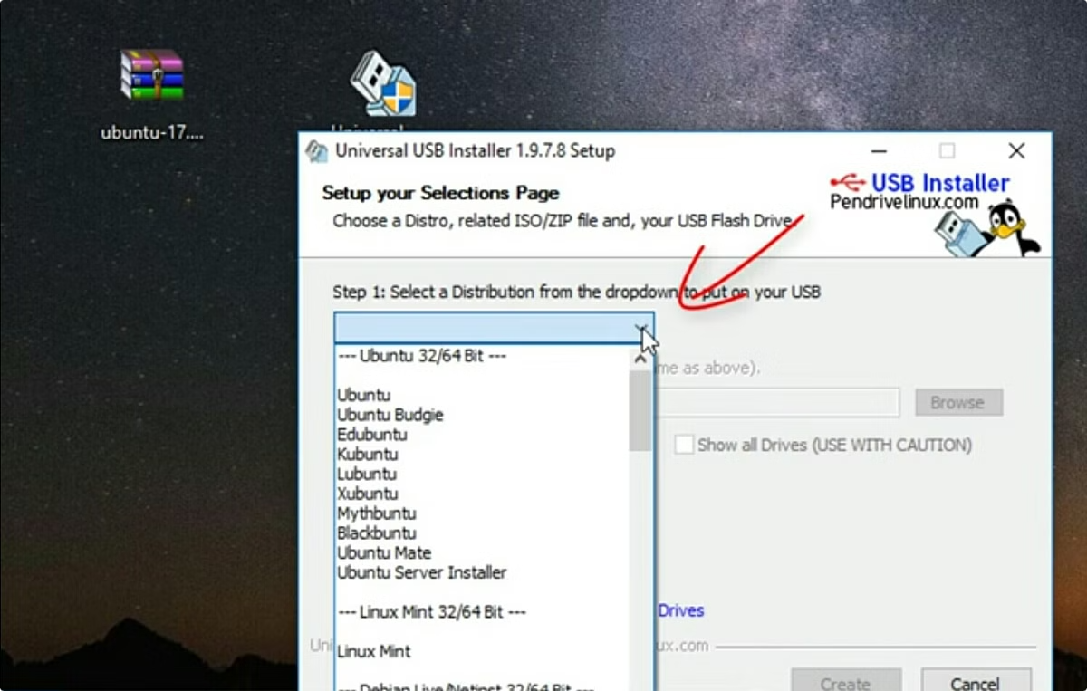
GNU/Linux Installation
Step 1
Download the desired Linux distribution.
Step 2
Create a bootable USB drive or DVD.
Step 3
Start the virtual machine and boot from the bootable media.
Step 4
Follow the on-screen instructions to install the Linux distribution.

Slide 8


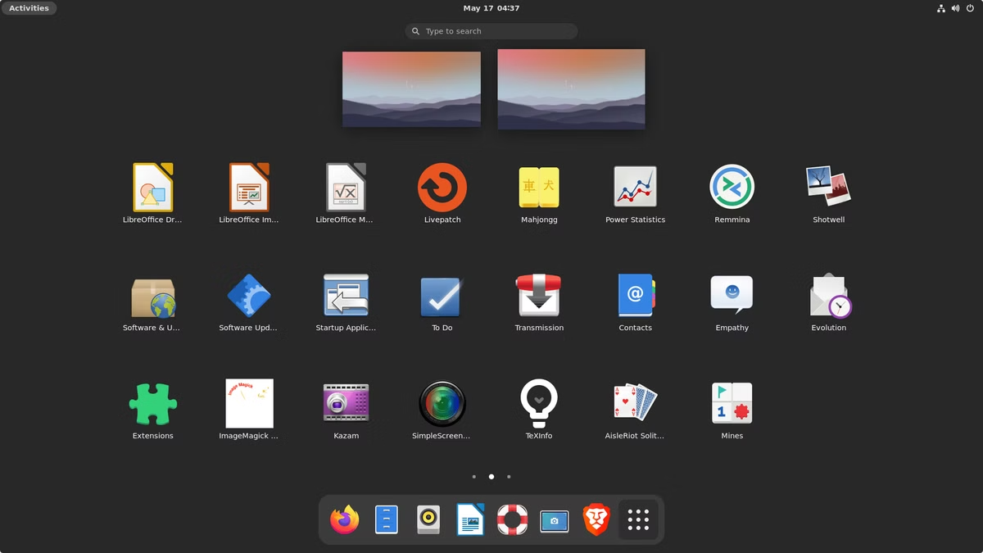


Graphical Environment
Terminal-Based
A minimal installation with only command-line access.
GNOME
A popular and user-friendly desktop environment.
KDE Plasma
Another widely used desktop environment, known for its customization options.

